Slide 1
An Effective Biologically-motivated Neural Network Algorithm to Real-time Autonomous Robot Navigation
Under Guidance of-
Prof. Dr, Nitin Pise
By-
Aditya Jain (302029)

Slide 2
Contents
Introduction to Neural Networks
Overview of Autonomous Driving
Literature Survey
Algorithms
Social Relevance
Future Scope
Conclusion

Slide 3
Introduction to Neural Networks
What are neural networks?
How does a neural network learn things?
What are the different types of learning?
Neural Network Architecture.

Slide 4
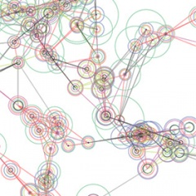
What are Neural Networks?
“Neural“ is an adjective for neuron, and “network” denotes a graph like structure.
The idea of ANNs is based on the belief that working of human brain by making the right connections, can be imitated using silicon and wires as living neurons and dendrites.
These inputs create electric impulses, which quickly travel through the neural network. A neuron can then send the message to other neuron to handle the issue or does not send it forward.
Similarly ANNs are composed of multiple nodes, which imitate biological neurons of human brain.
The nodes are connected by links and they interact with each other.
The nodes can take input data and perform simple operations on the data.
The result of these operations is passed to other nodes.

Slide 5
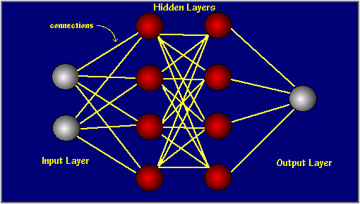
Neural networks are typically
organized in layers.
Layers are made up of
interconnected nodes which
contain 'activation function'.
Patterns are presented to the
network via the 'input layer',
which communicates to one or
more 'hidden layers'.
Actual processing is done via a
system of weighted 'connections' at the node.
The hidden layers then link to an 'output layer' where the answer is output.

Slide 6
LEARNING
How does this learning occur?
In artificial neural networks, learning refers to the method of modifying the weights of connections between the nodes of a specified network.
The learning ability of a neural network is determined by its architecture and by the algorithmic method chosen for training.
Backpropagation is an algorithm which can be used to get set of weights which will give us minimum errors.

Slide 7
CONTD…
SUPERVISED LEARNING
UNSUPERVISED LEARNING
A teacher is there to tell whether the prediction is correct or not during learning.
The training data consist of pairs of input and desired output values to measure performance.
Example- Autonomous Driving applications
This is learning by doing.
In this approach no sample outputs are available for performance prediction.
Mainly it is clustering. Divide inputs into clusters of depend on their similarity.
Example- Detecting Spam in emails

Slide 8
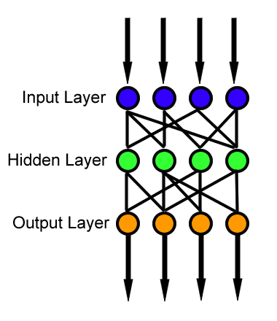
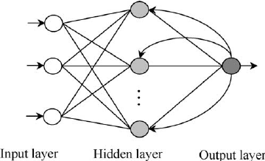
Neural Network Architecture
Feed Forward Neural Network
The first layer is the input and the last layer is the output. If there is more than one hidden layer, we call them “deep” neural networks.
The activities of the neurons in each layer are a non-linear function of the activities in the layer below.
Recurrent Neural Networks
These have directed cycles in their connection graph.
They can have complicated dynamics and this can make them very difficult to train.
They are more biologically realistic.

Slide 9
Overview of Autonomous Driving.
Introduction.
Convolutional Neural Networks.
Improving Performance of CNN.
Pavement Detection

Slide 10
Introduction
Previous attempt to autonomous driving use of precalculated data gathered from different sensors on car like distance from edge of road or car in front etc.
But this is not how humans drive, as human we drive on locally available knowledge, mainly sight.
This explores and evaluates use of visual input for autonomous driving.
Neural Networks can be trained to process visual inputs and take decisions on basis of that about the direction to steer.
Convolutional Neural Networks are such type of neural networks which can process on visual input efficiently.

Slide 11
Introduction (cont...)
But deciding only steering direction perfectly does not make a autonomous driving car.
A car has to detect different pavement marks and symbols on road, and process on that information to modify its steering decisions.
Object detection and pedestrian detection are of crucial importance to avoid collision and prevent damage.
Car running autonomously may take undesired long path to reach destination, this must also be prevented by model based path planning.
Many algorithm works in parallel to take car to its destination.

Slide 12
Convolutional Neural Networks
Convolutional neural network (CNN) is a type of feed-forward artificial neural network.
Connectivity pattern between its neurons is inspired by the organization of the animal visual cortex (part of brain which process visual information).
CNN have proven to excel in categorical image classification, and can be used to deciding steer values.
They have learned to sort images into categories even better than humans in some cases.
CNN requires very high computation, so it was inefficient for autonomous cars which has to take real time decisions.
GPGPU have now made it possible to implement CNN in real time.

Slide 13
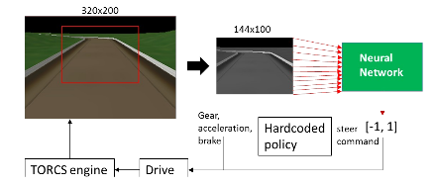
Convolutional Neural Networks (for Autonomous Driving Applications)
The Image of road is taken from
the top of car and passed to the
Pre-processing module.
Pre-processing module discard
borders and applies filter to
remove unwanted features.
Each input pixel unit value is
scaled so values from 0 to 255 are
transformed to 0 to 1 and provided
to CNN.
CNN outputs a single value that is used as a steering value, which is combined with other driving decisions to take action.

Slide 14
Improving Performance of CNN.
Performance of CNN measured on basis of various parameters:
Mean Square Error (MSE)
Time Stuck
Damage
These parameters can be used to train CNN to improve its performance.
Preprocessing the input image like changing colour of road, removing unwanted features.
Scaling up output i.e. is increased no of output units on last layer. More the number of output units more specific is steer value.
Diversity of training data improve accuracy of autonomous car. The car which has been trained on multiple tracks performs better.

Slide 15
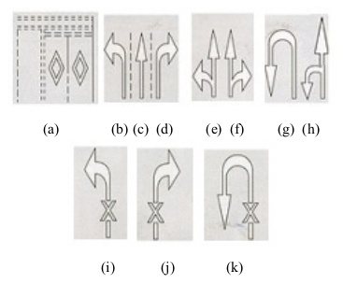
Pavement Detection
Pavements are the marks on road to guide driver about direction.
Assumed that roads are black and marks are white.
Image of road is converted into grayscale.
We start scanning pixel values of image row by row.
Left side of mark had large positive pixel value and right
side of mark had large negative pixel value.
Algorithm process each row one by one and make a binary
image of that.
Algorithm find largest group of non zero values and then identifies the top and bottom marks.
These are feeded into CNN for classification.

Slide 16
Literature Survey

Slide 17
Sr. No. | Paper | Technology Used | Algorithms | Advantages | Disadvantages
1 | Towards Neuroimaging real-time driving using Convolutional Neural Networks., 2016 | Convolutional Neural Networks for autonomous steering. | Categorical image classification | Deep Convolutional Neural Network have been proved ideal to process complex visual data, particularly in image classification | Processing or working with neural networks requires too much computation quickly requires use of GPGPU, parallel processing.
2 | Progress in Neural Network-based Vision for Autonomous Robot Driving, 2002 | Convolutional Neural Networks | Training with Gaussian noise and structured Noise | Training with different types of noise let CNN handle rare situations without any damage.

Slide 18
Sr. No. | Paper | Technology Used | Algorithms | Advantages | Disadvantages
3 | Vision-based Detection and Classification of Pavement Mark using Neural Network for Autonomous Driving System | Edge pairing to find a pavement mark | Edge pairing algorithm to classify different type of pavements using Neural Networks. | 1. Pavements detection helps cars to improve its decision process. 2. Different turning which can’t be seen during run because of obstacle can be detected by pavements. | Overhead increase during run of car, car has to do extra processing may affect its real time decisions.
4 | Moving Towards in Object Recognition with Deep Learning for Autonomous Driving Applications, 2016 | Convolutional Networks architectures, SVM classifiers . | Bag of visual words algorithm. | Object detection and pedestrian detection help cars to avoid collisions with them. | Overhead increase due to extra processing a car might have to do to detect objects in its path.

Slide 19
Algorithms -
Back Propagation Operation in feed forward neural networks.
Bag of Visual Words algorithm for object detection.

Slide 20
Backpropagation Algorithm
Neural networks can learn their weights and biases using the gradient descent algorithm and thus minimizing the cost function.
Backpropagation is an algorithm for fast computation of gradient descent. Today, the backpropagation algorithm is the workhorse of learning in neural networks.
Algorithm-
Firstly let us train take training example and do forward propagation to get output values in output layer.
Now we calculate “error” in each node of layer i.
for layer last layer, errors are 𝛿(i)=y-a(i)
Where, g’(z) is derivative of sigmoid func
Ɵ is weights in layer
g(z) = sigmoid function = 1/1-e^(-z)

Slide 21

BackPropagation (cont...)
First layer doesn’t have any error terms.
The name back-propagation is given because we go back layer by layer to compute errors in each layer.
The Backpropagation algorithm try to minimize the cost function, by changing weights. Its uses derivative of cost function to change value of weights.
Finally algorithm after number of iterations will find optimal value of weights and minimize our cost function.

Slide 22
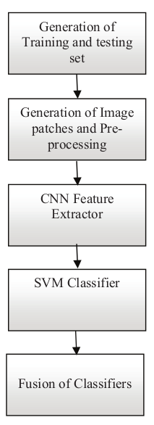
Bag of Visual Words Algorithm (BoW)
In applications of object detection for autonomous driving BoW have
several advantages.
The Algorithm works as follows
Divide image to nine patches (visual words).
Resize to 64x64 each patch and convert to grey image.
Construct a CNN with ten layers consisting of input, convolution,
max pooling etc.
Apply Stochastic gradient descent to proposed CNN for applying to
each image patch.
Extract the features from full convolution layer.
Use linear multi class SVM classifier for training the features,
Perform the decision fusion to the outputs of nine SVM classifier.
(SVM are support vector machines used classify data)

Slide 23
Social Relevance
Potential reduction in traffic collisions (and resulting deaths and injuries and costs), caused by human-driver errors.
Automated cars could also reduce labour costs.
Higher speed limits, smoother rides; and increased roadway capacity; and minimized traffic congestion.
Improved ability to manage traffic flow, combined with less need for traffic police or even road signage since automated cars could receive necessary communication electronically.

Slide 24
Future Scope
Autonomous driving will change the way we think about traffic. Today’s traffic is result of actions of thousands of drivers. But with self driving cars, a server can know about destination of all vehicles and can manage traffic more efficiently.
When used for car sharing, the total number of cars is reduced. Less fuel is used.
Cars will know your office timings and will be ready to pickup you at office finish hours.

Slide 25
Conclusion
CNNs are one of the important algorithms in autonomous driving application.
CNN are not only used for deciding steer direction but also used for pavement detection, object and pedestrian detection.
CNN can be combined with decisions of other nearby autonomous cars and take decision on basis of that, improves traffic management.
CNNs are the future of autonomous driving, with the advancement in parallel programing the use of CNN can be widely increased.
Autonomous driving can improve standard of living by decreasing labour, accidents, congestion etc.

Slide 26
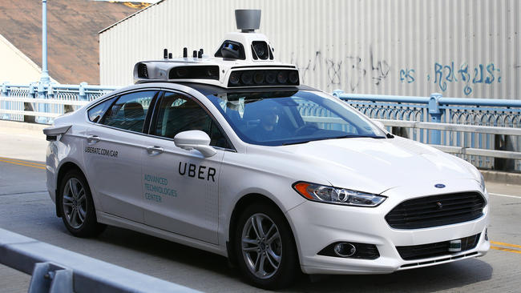
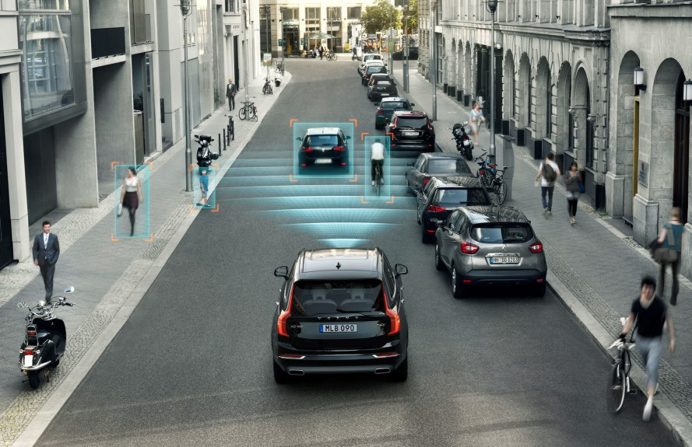
Thank You !!!

